Slide 1

“UNGAY’BULALI-UZOY’DINGA” COMMUNITY EMPOWERMENT PROGRAM FOR SOWETO-ON-SEA COMMUNITY
PRESENTED BY BUKANINDALO NPC
Notes:
To give a bit of background, this year WESSA is 90 years young. Almost a century of people caring for the earth.
We recognized a long time ago that in order to take care of the earth, we have to take care of people and in 2003 we joined hands with the Foundation for Environmental Education based in Denmark.
We are 1 of 64 countries in the world operating the FEE Eco-Schools programme and globally 49 000 schools are involved.

Slide 2
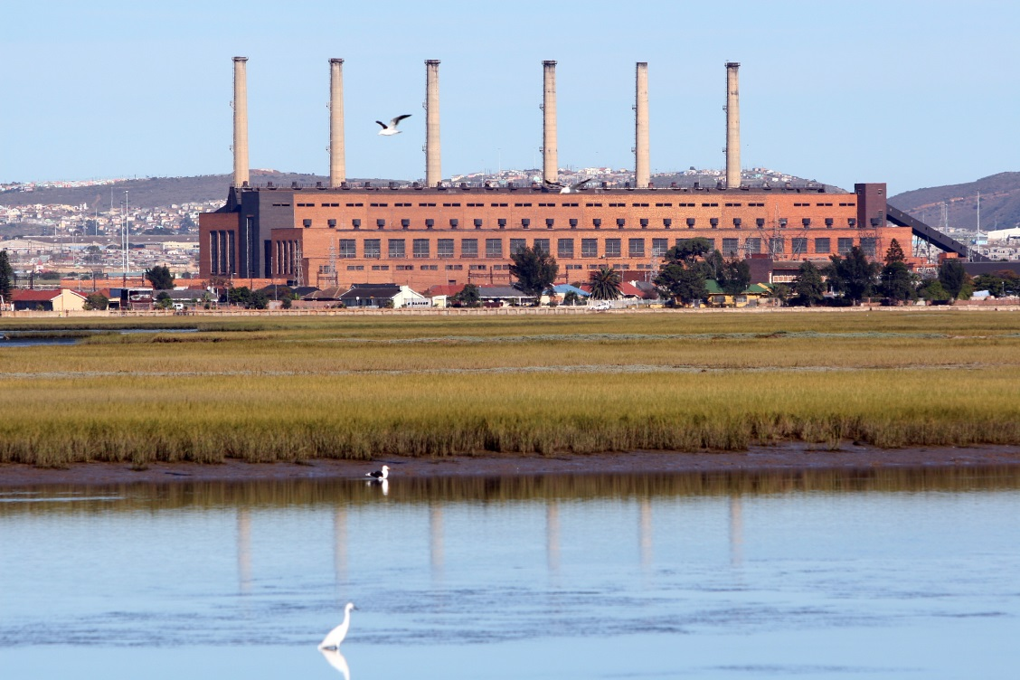
BACKGROUND
Water Bodies in Southern Africa are disappearing at an alarming rate. They are suffering from many problems- of which Climate Change plays a major part. Rivers are drying up and others are highly polluted due to human activities. As is the case at Swartkops Estuary, Industrial and Waste Water Treatment works discharges, storm water runoffs and agricultural practices plays a major part in destroying this prestige natural area. This estuary has the third largest salt marsh in South Africa and has been earmarked as a Ramsar Site. But due to its current status some of the water sports and activities are no longer taking place. It has become a health risk for fisherman to catch fish in such high contaminated area.

Slide 3
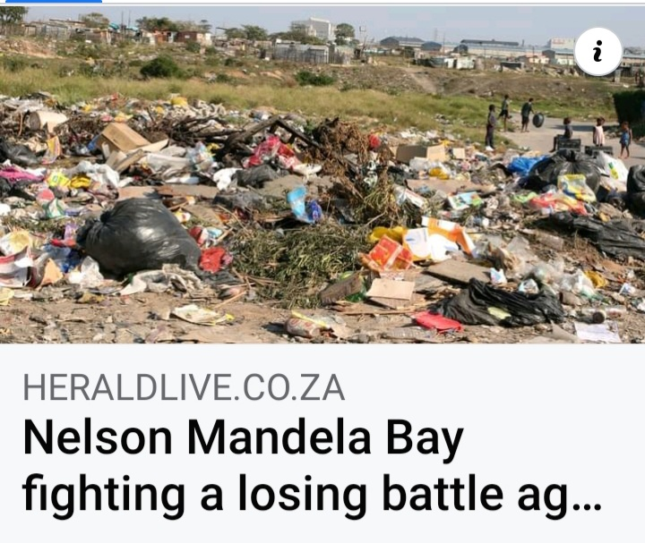
NEWS PAPER CLIP

Slide 4
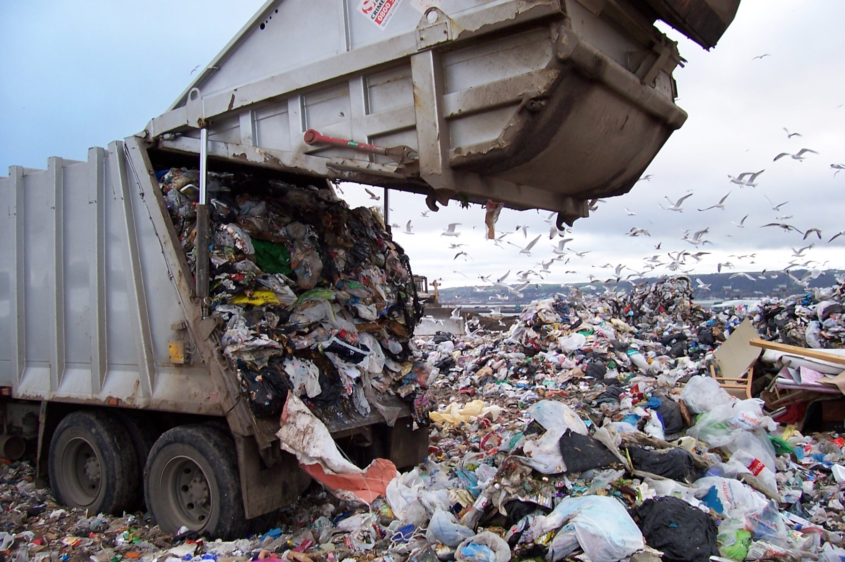
WASTE MANAGEMENT
Waste is directly linked to human development, both technologically and socially. Most people accumulates tons of waste from paper, clothing, food, to computers which are classified as E-Waste . Landfill sites are filling up at an alarming rate. This is a national crisis as more illegal dumping sites are created and some end up polluting our rivers, wetlands and also open spaces.

Slide 5
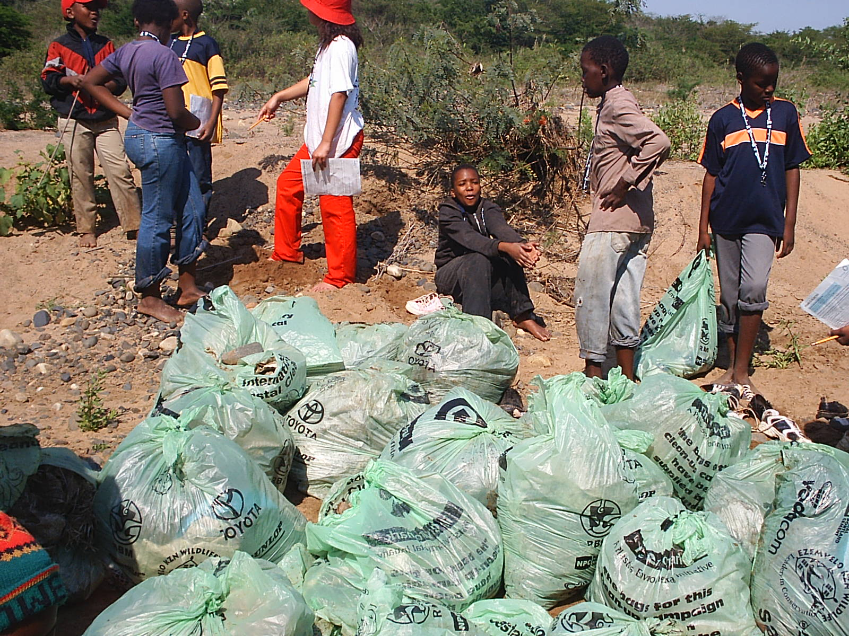
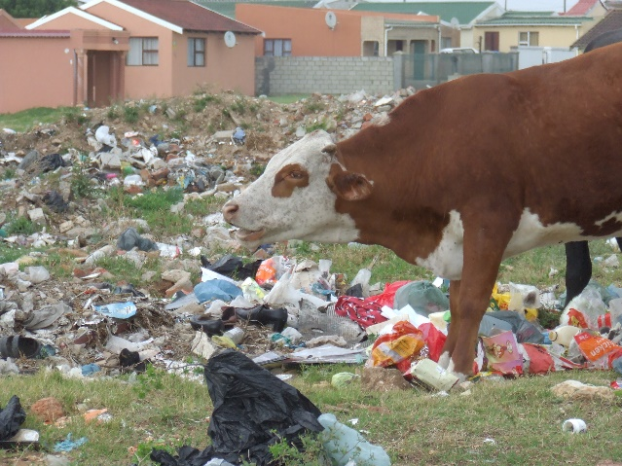
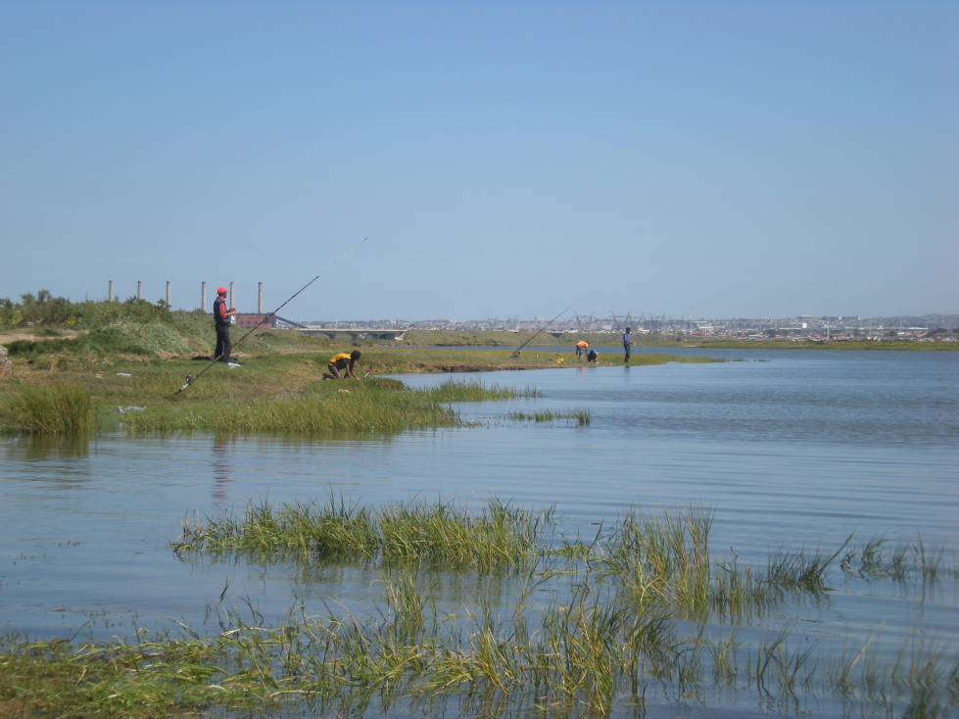
Sustainable Development Goal 14- Life below Water:
States that by 2030: Marine and coastal ecosystems will be healthier, more resilient and have benefitted from restoration and protection efforts for over at least a decade.
It is believed that those small individual actions that one does for the Swartkops estuary today, will have a larger impact in the future. This is one of the reasons why communities that are staying around these catchment areas cannot be left without being educated on the importance of keeping these areas protected.

Slide 6
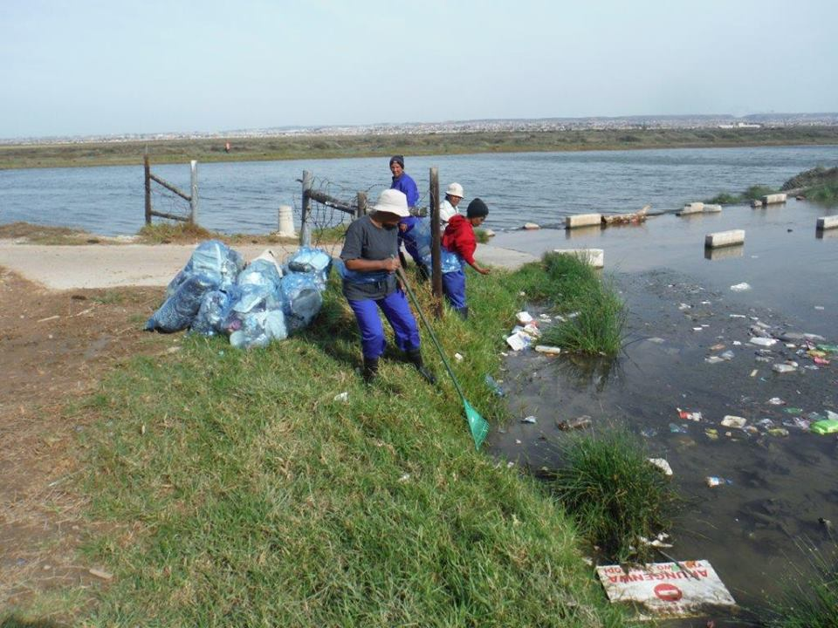

Slide 7
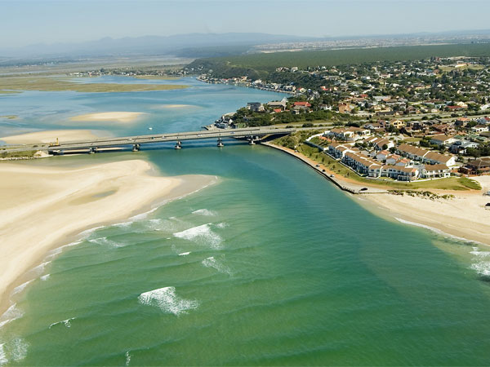
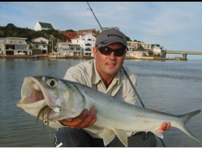
SWARTKOPS BACK TO ITS FORMER GLORY

Slide 8


ACTION PLAN
To approach councilor's office - to get buy-in for the community empowerment waste management project, namely, “UNGAY’BULALI- UZOY’DINGA” (Don’t destroy, You might need it one day)
(Project would focus on community development which would capacitate co-operatives and youth structures that stays within the river banks about waste management: waste identification, how to sort at source; recycling and upcycling
Do hands-on activities; ie. Eco-bricks making,
Encourage them to acknowledge Enviro Calendar Days

Slide 9
INTERNATIONAL COASTAL CLEAN-UP DAY (SEPTEMBER)
To ask Cllr for 25 adults (co-operatives)
Organize NMBM Waste section to be part of the event
Forward Invites to DEDEAT, DEA, ISUZU, ECPTA , etc.
Do clean up

Slide 10
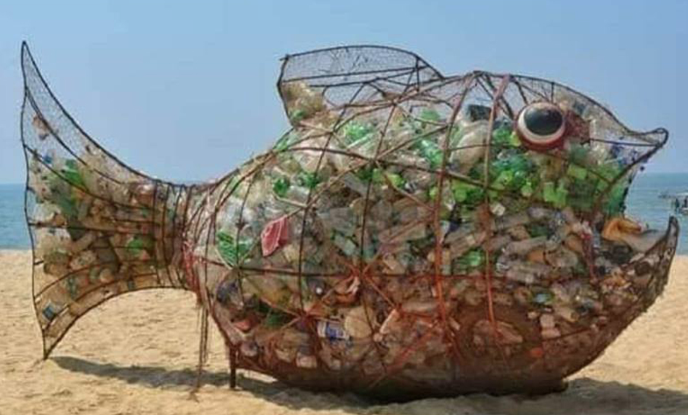
FISH WIRE NETS FOR RECYCLABLES

Slide 11
FOLLOW-UP PROGRAM
TRAINING SESSIONS: 5 DAY SESSIONS
ENVIRONMENTAL EDUCATION
CLIMATE CHANGE
WASTE MANAGEMENT
WETLANDS
ESTUARIES
COLLECT 2LT BOTTLES FOR ECO-BRICKS-
ORGANIC GARDENS
IDENTIFY PIECE OF LAND TO START VEGETABLE GARDEN

Slide 12
FOLLOW-UP VISITS
VISITS WILL BE DONE TO ASSESS PROGRESS OF THE PROJECTS
REPORTS TO BE WRITTEN AND BE SUBMITTED AS PER FUNDER STIPULATION

Slide 13
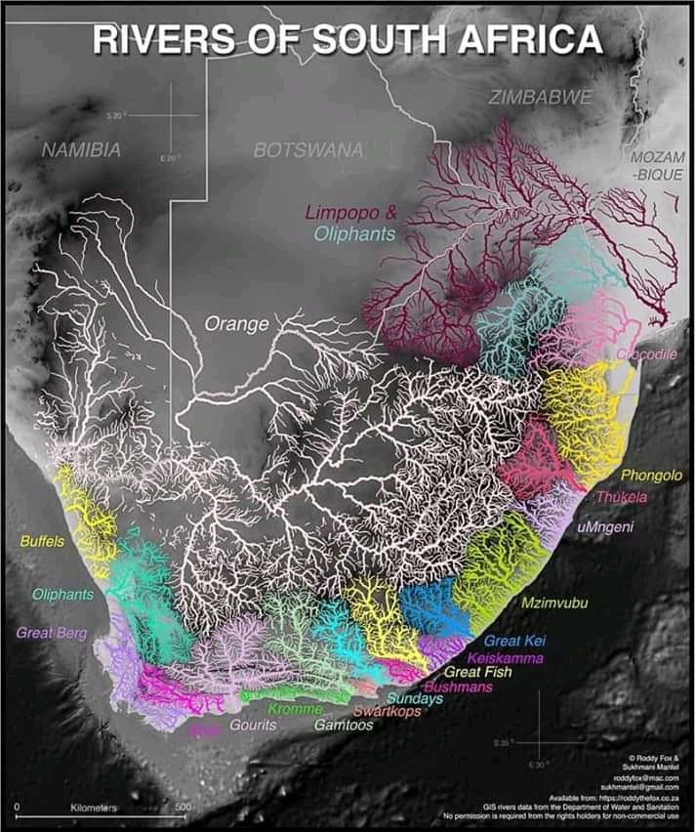
FUTURE PLANS

